Slide 1
DP DRUG DISTRIBUTION
PRESENTED BY OLUGBENRO DAVID

Slide 2
OBJECTIVES
What are we talking about?
Cleaning Data
Understanding continuation rates of existing clients
Identify the major factors that contribute to the distribution of DP drug(Receiving and Refilling on this Drug over time)
What Solutions or Interventions can we apply to bolster both the receiving and refilling of the drug in Kenya.

Slide 3
CLEANING DATA
Steps taken to Clean Data
- Remove cells with missing values, Null Values, or Zero
Check for repeated entries
Eliminating extra spaces
Seperating Blood pressure variables into two different columns to clean properly(systolic and Diastolic).
Flitering Entries with Absurd Values like too high or too low blood pressure, low ages and impossibly high ages, Absurd weights and Heights

Slide 4
Understanding Continuation Rates
Continuation rates measure how many times clients come back for a refill over the four(4) months in the Dataset
The chart tells us that there was a 100% return rate for the first month
From the second month there was a continuous decline up till the 6th month.
There was a 42.4% decrease in the 2nd month and 34.1% decrease in the 3rd month.
I created a new column to calculate the summary of each client for the 4 refill months and the mean of all clients was 2.09(meaning on the average, clients came back only 2.09 times)

Slide 5
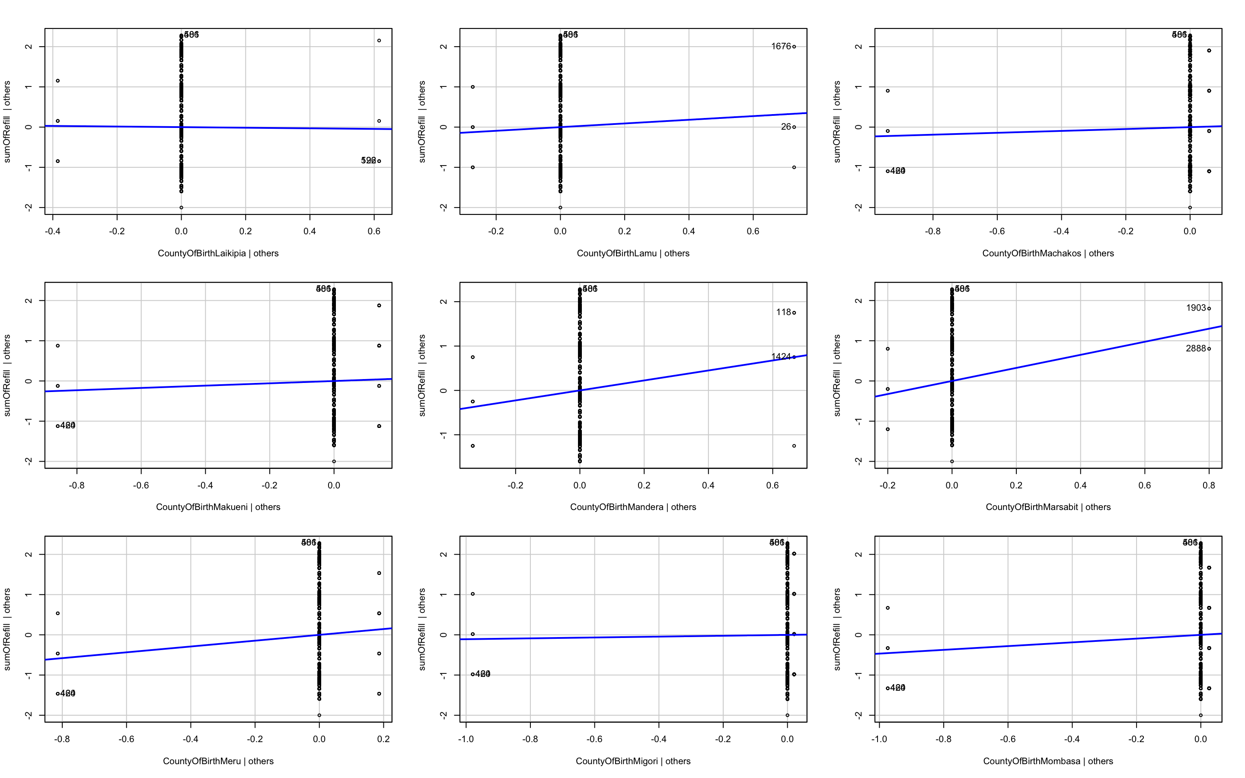
How does continuation Rate vary by county?
While we cant list all 34 counties thereabout, we will show which counties had highest continuation rates and which had the lowest.
First Five Counties from the highest continuation rates to lowest
Mandera, Marsabit, Meru, Kisii, Nyamira
(We used Multi Linear Regression in R Programming to arrive at counties with lowest P values when matched against the Sum of all 4 Refill months)
- First Five counties with Lowest continuation rates
Laikipia- Lowest continuation rates in Kenya, followed by
Siaya, Nyeri, Garissa, Nairobi

Slide 6
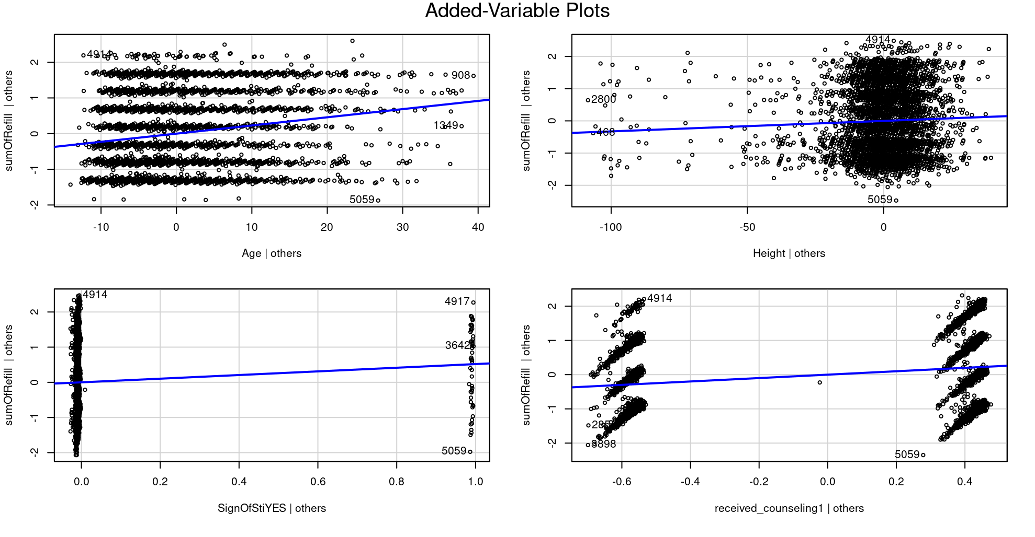
INTERVENTION TO THE PROBLEM FACED
FOUR VARIABLES THAT
HAVE THE MOST IMPACT
ON THE COMTINUATION
AND RECEIVING OF THE
DRUG.
Multi linear regression plot of factors plotted against the sum of all 4 refill months

Slide 7
INTERVENTION TO THE PROBLEM FACED
There are four Variables that seem to determine the rate of Drug Received and its continuance, only three(3) are actionable, which are Age, Sign of STI and Receiving Counselling.
According to Relevant literature on the topic of behavioral sciences, understanding what tends to impact decisions of people may help in swaying their actions in the right direction and in the case of this Study sway them on to the path of Healthy Sexual Practices.(According to an article published by Ohio University’s College of Health Sciences: “What Is Behavioral Science & How Does It Relate to Public Health”).
Therefore I Propose that the intervention introduced should be Counselling because based on data analyzed, It has a strong relationship with Receiving and Continuance of the drug JP, and from a literature point of view of the article cited above and thalers evolution of behavioral economics what better way to sway human behavior than the implementation of Sound Counselling.
Cashew to Nuggests by Thaler explains drastic measures that humans need to take to curb their desires i.e the bowl of cashew and odysseus tying himself to a ship post. Counselling persuades human behavior to pursue that drastic measure drug which is free, and easily accessible while emphasizing on the “lack of risk or side effects” of said drug.

Slide 8
EVALUATING INTERVENTIONS
Over the past one(1) Year we have implemented the Counselling Intervention and we have also seen a 25% increase in the clients that have received Dp and a 30% increase in those clients continuously refilling.
Can we say Counselling has caused the increase? YES
We have used counselling to target other factors that affected continuation rates i.e Age and Sign of STI
Age: Younger sexually inactive participants and married participants tend to back away from the drug, but counselling helps them understand that being sexually inactive or having one partner in marriage doesn’t eliminate the risk of HIV hence they shouldn’t eliminate the free HIV preventive drug.
Sign of STI: HIV has the ability to live in ones body unnoticed for up to 2 years before becoming AIDS, so its not until one sees signs before one starts taking precautions, Prevention is better than cure.
We used targeted Counselling at different age groups and their different thoughts on HIV using Pamphlets, fliers and other advertisement platforms both on media and Clinics all around Kenya, and at the same time offering free counselling sessions at schools and hospitals.
Our counselling also covered getting numbers/mails of clients to send reminders that our drugs are Risk Free therefore eliminating any thoughts of “drug risk” that may affect their behavior.

Slide 9
ASSESING THE EFFECTIVENESS OF THE INTERVENTION
The key to the success or effectiveness of any intervention is the measure of outcome throughout the process or better still before and after the implementation of such measure.
One method out of many that an ascertain the effectiveness of this intervention I have proposed is “Behavioral Changes”
We measure the new and refilling clients, using avenues like questionnaires to determine
Where did they hear about the drug
How many times have they returned for a refill and have they been counselled or come across any of the counselling/informative platforms
Also cross check frequency of clients continuation before and after we rolled out counselling intervention.
Pay attention to the age group of constant and new clients to ascertain that targeted counselling has affected all groups of persons

Slide 10
THANK YOU FOR LISTENING!!!

